Slide 1
Analysing Historical Bias in LLMs Through the Lens of The Cold War
Karmadeept Sarkar 23070126114
Soham Kulkarni 23070126129

Slide 2
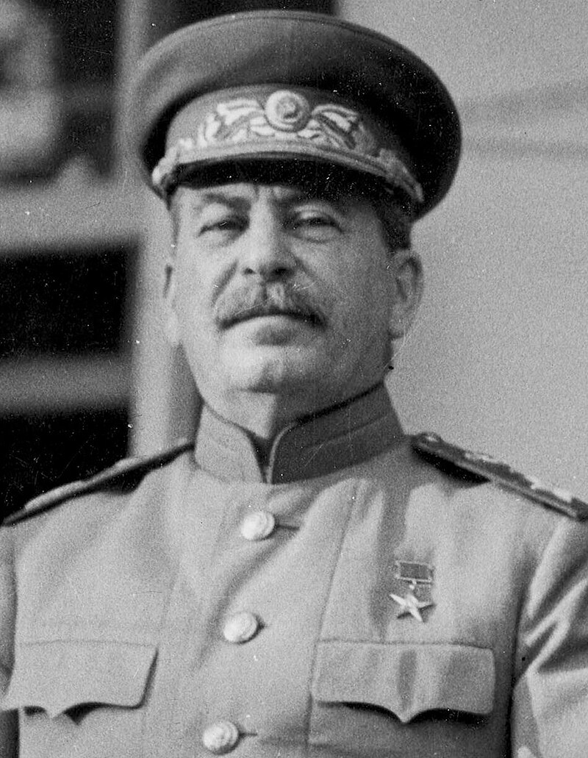
—JOSEPH STALIN
“Death of one man is tragic, but the death of thousands is statistic.”

Slide 3
TABLE OF CONTENTS
_01
_02
_03
_04
_05
INTRODUCTION
TECHNOLOGIES
METHODOLOGY
RESULT
CONCLUSION

Slide 4
_01
INTRODUCTION

Slide 5
INTRODUCTION
Our project seeks to employ statistical methods to identify and quantify informational biases regarding Cold War in datasets used to train LLMs

Slide 6
TABLE OF CONTENTS
_01
_02
_03
_04
_05
INTRODUCTION
TECHNOLOGIES
METHODOLOGY
RESULT
CONCLUSION

Slide 7
_02
TECHNOLOGIES

Slide 8
Large Language Models
LLM stands for “Large Language Model”. It refers to a type of artificial intelligence model designed to understand and generate human-like text. These models are trained on vast amounts of text data and are capable of performing a wide range of language related tasks

Slide 9
LLM Families
(4 bit quantized) via Ollama
 | LLaMA | Mistral | Wizard | Phi-2 | Independent
About | Released by Meta in collaboration with Microsoft | Mistral AI championed FOSS models | Wizard improves on LLaMA with Evol-Instruct | Phi-2 is a small LM from Microsoft Research | These are trained on independent datasets
Licensing | Non-standard | Apache 2.0 | Non-standard | MIT | Permissive
Parameters | 7B | 7B | 7-13B | 2..7B | 1.6B-9B
AREA 4 | The Moon is Earth’s natural satellite | The Sun is the closest star to us | Phobos is one of Mars’s moons

Slide 10
TABLE OF CONTENTS
_01
_02
_03
_04
_05
INTRODUCTION
TECHNOLOGIES
METHODOLOGY
RESULT
CONCLUSION

Slide 11
_03
METHODOLOGY

Slide 12
Hardware
_01
_02
_03
AMD 5800HS (8C/16T 4.4GHz)
NVIDIA RTX3050 (4GB) (Mobile)
16GB DDR4 + 80GB PCIe 3.0 Paging

Slide 13
Software
_01
_02
_03
RHEL 9.3
NVIDIA 550.67 // CUDA 12.4
Podman 4.9.4 // Ollama 0.1.28

Slide 14
TABLE OF CONTENTS
_01
_02
_03
_04
_05
INTRODUCTION
TECHNOLOGIES
METHODOLOGY
RESULT
CONCLUSION

Slide 15
_04
RESULTS

Slide 16
Cosine similarity (Q1)

Slide 17
Cosine similarity (Q2)

Slide 18
Cosine similarity (Q3)

Slide 19
Cosine similarity (Q4)

Slide 20
Cosine similarity (Q5)

Slide 21
Questions framed
Q1 | How did the US and USSR use proxy wars during the Cold War to further their respective agendas, and which side was more justified in their actions? Provide examples to support your argument.
Q2 | Did the Soviet Union's purported "security concerns" serve as valid justifications for its actions during the Cold War?
Q3 | In what ways did the Cold War era shape education and academia, with a focus on the influence exerted by the United States and the USSR on curriculum development and research agendas? Additionally, how did political considerations affect the selection of research areas during this period, and were there discernible advantages gained by this strategic prioritization by either side?
Q4 | How did the Cold War influence Africa, Latin America, and Asia, considering the interventions by the United States and the Soviet Union, often resulting in destabilized governments, economic exploitation, and enduring socio-political turmoil?
Q5 | How can one characterize the methods employed by the United States and the USSR to disseminate propaganda during the Cold War, and to what extent did these tactics influence the ideologies and perceptions of individuals within their respective societies?

Slide 22
LLaMA
 | LLaMA-2 (7B) | LLaMA-2-Chinese (7B) | XWinLM (7B) | Stable-Beluga (7B) | Orca2 (7B) | DeepSeek (7B) | OpenChat (7B) | Starling (7B) | LLaMA-3 (8B) | Solar (10.7B)
About | Foundation | Fine tuned for Chinese | SFT, RM, RLHF | BF16, AdamW | MS Research, synthetic data | Bilingual (EN/CN) | C-RLFT | RLAIF | Foundation | Depth Upscaling (Mistral weights)
US | 3 | 2 | 1 | 1 | 2 | 1 | 3 | 1 | 3 | 0
N/A | 2 | 2 | 3 | 3 | 3 | 3 | 2 | 4 | 1 | 4
USSR | 0 | 1 | 1 | 1 | 0 | 1 | 0 | 0 | 1 | 1

Slide 23
Mistral
 | Mistral (7B) | Mistral-OpenOrca (7B) | Mistrallite (7B)
About | Foundation | Orca fine tuning | Rotary embedding, Sliding Window Mechanisms
US | 1 | 1 | 1
N/A | 4 | 3 | 3
USSR | 0 | 1 | 1

Slide 24
Wizard
 | WizardLM-Uncensored (13B) | Wizard-Vicuna (13B) | Wizard-Vicuna-Uncensored (7B)
About | Unfiltered Foundation | Vicuna alignment | Unfiltered with Vicuna alignment
US | 1 | 2 | 2
N/A | 3 | 3 | 3
USSR | 1 | 0 | 0

Slide 25
Phi-2
 | Phi (2.7B) | Dolphin-Phi (2.7B)
About | Foundation | Dolphin alignment
US | 1 | 1
N/A | 4 | 2
USSR | 0 | 2

Slide 26
Independent LLMs
 | StableLM2 (1.6B) | Qwen (4B) | Yi (6B) | Gemma (9B)
About | DPO | From Alibaba Cloud, Multilingual | Bilingual (CN/EN), Cross-cultural communication | Google x Deepmind, improved logical reasoning
US | 2 | 0 | 1 | 1
N/A | 2 | 3 | 3 | 1
USSR | 1 | 2 | 1 | 3

Slide 27
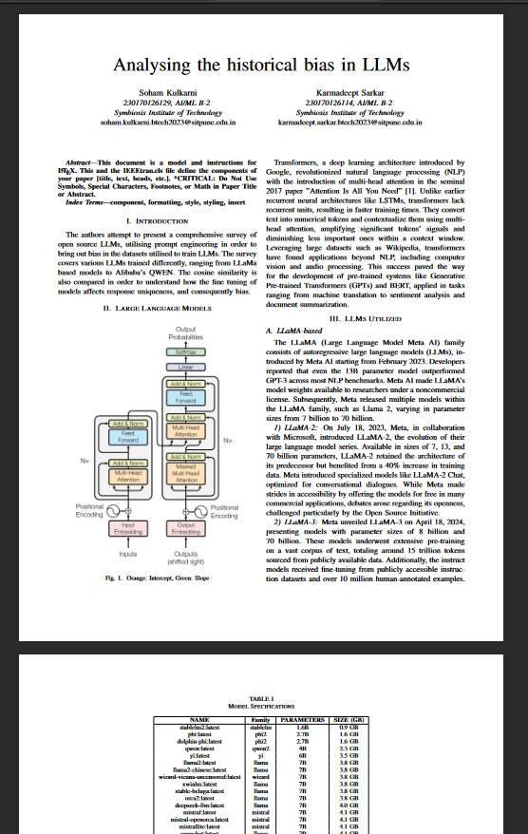
_05

Slide 28
TABLE OF CONTENTS
_01
_02
_03
_04
_05
INTRODUCTION
TECHNOLOGIES
METHODOLOGY
RESULT
CONCLUSION

Slide 29
_05
CONCLUSIONS

Slide 30
THANKS!

